Slide 1

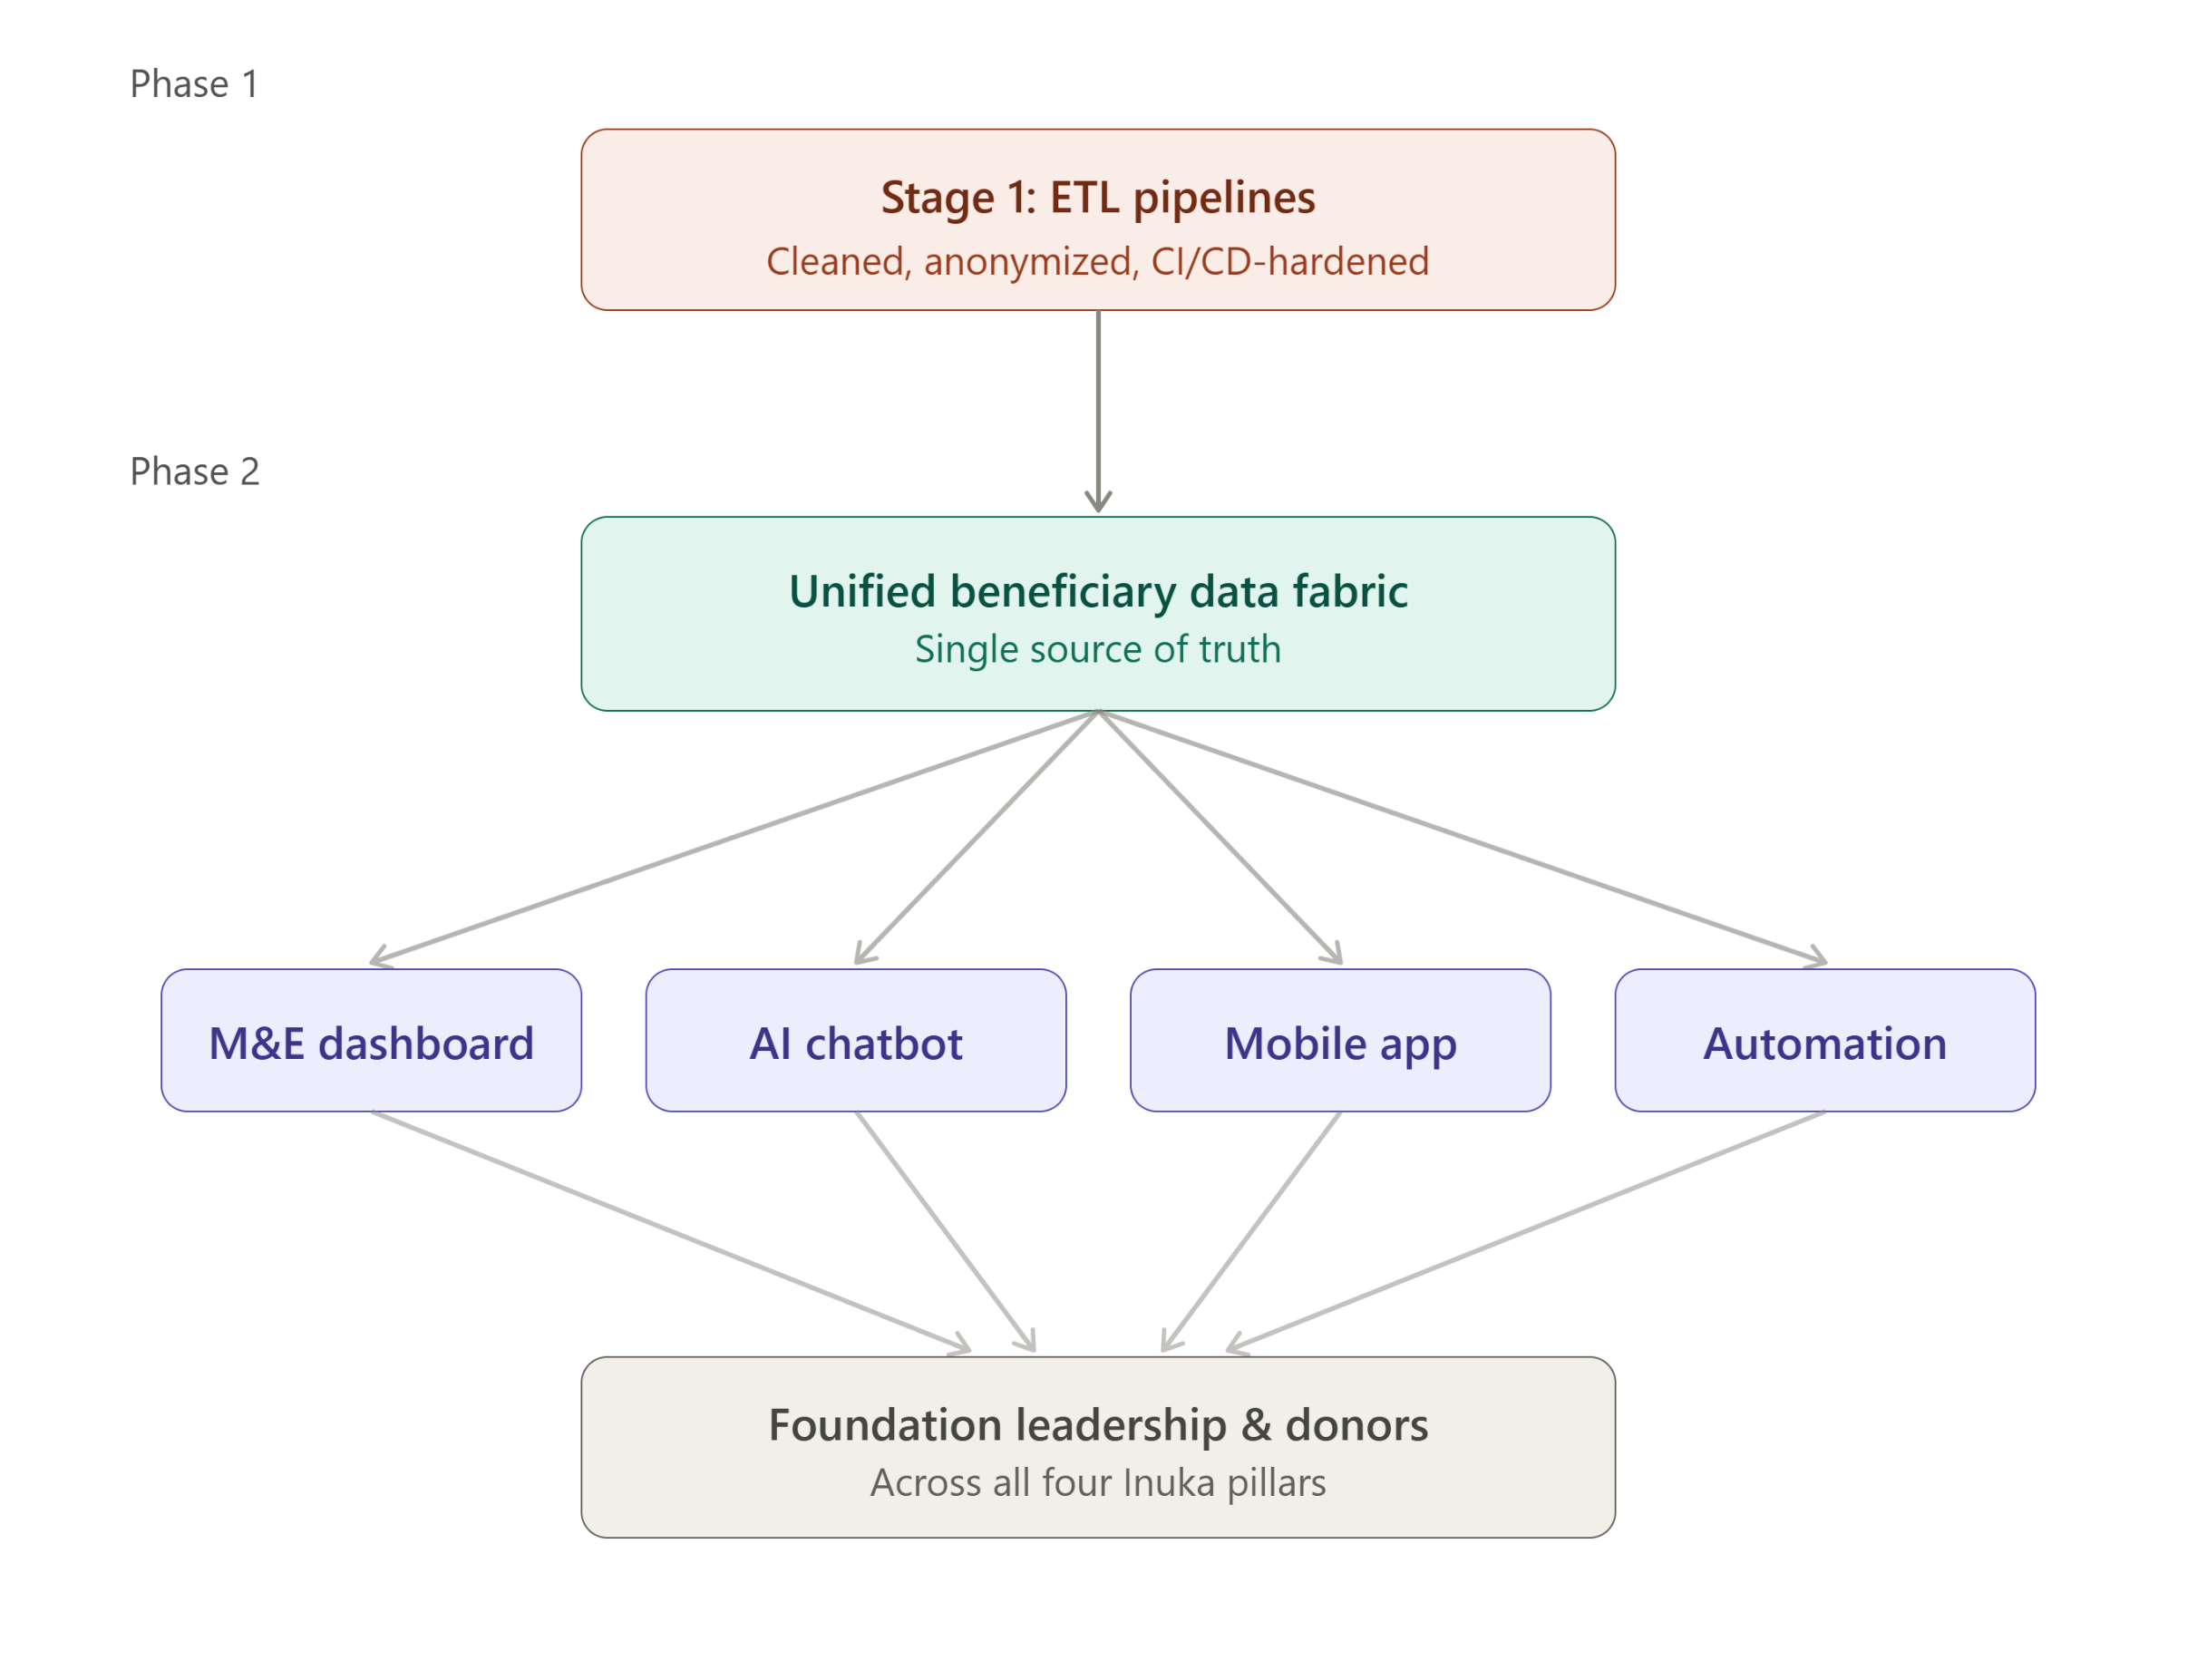
Real-Time M&E Dashboard & Web Integration
From reactive spreadsheets to a live, unified view of every beneficiary across Inuka's four pillars.
01

Slide 2

THE PROBLEM
Inuka Foundation’s M&E reporting is fragmented, manual, and delayed, limiting real-time visibility into program reach, outcomes, impact, and performance.
Scholarship, Plus, Vocational, and Tech programs report separately.
The same beneficiary may be counted multiple times across pillars.
Leadership and donors receive historical reports instead of real-time insights.
Public visibility into impact is limited.
10

Slide 3
Solution
Stage 1 gave us clean pipelines. Stage 2 makes them live.
4 Pillar Systems
Event Stream
Identity Graph
Live Aggregation
Dashboard + Website
→
SIS · Field app · LMS · Bootcamp
CDC + Webhook ingest
Unified beneficiary ID
15-Second window
Admin + Public Widget
Unifies beneficiary records across all pillars.
Streams updates continuously from source systems.
Provides one source of truth for reporting.
Delivers live dashboards for management.
Powers a public impact widget on the Foundation website.
Enables offline field-data capture and synchronization.
06

Slide 4
Product
Inuka Pulse: One live view, four pillars, zero spreadsheets.
EXECUTIVE VIEW — LIVE
Executive View
Events streamed/24h
Live reach & outcomes, all 4 pillars
Unique beneficiaries
4,820
34,720
Data Fabric
How the identity graph resolves duplicates
Median freshness
Officer hrs saved/wk
22 sec
43.5
Website Embed
Same numbers, public & read-only
4 pillars: Scholarship · Plus · Vocational · Tech — deduplicated via one identity graph, updating live.
04

Slide 5
WEB INTEGRATION
How We Reach Customers
LinkedIn & Professional Networks- Targeting M&E professionals, NGO directors and development – sector technology leaders.
2. Case-study Marketing with measurable outcomes e.g. 43.5 officer Hours Reclaimed every week, 2-3 week reporting lag reduced toward near real time visibility.
3. Donor Ecosystem for funding deployment for their implementing partners.
4. Demonstration led selling for a given existing reporting process instead of selling the software

Slide 6



Target Market
Internal
External
Program officers
M&E Teams
Foundation
Leadership
Board Members
Donors
Partners
Website Visitors
Stakeholders
12 officers currently involved in reporting processes.
4 program pillars integrated.
1 unified source of truth.
14

Slide 7
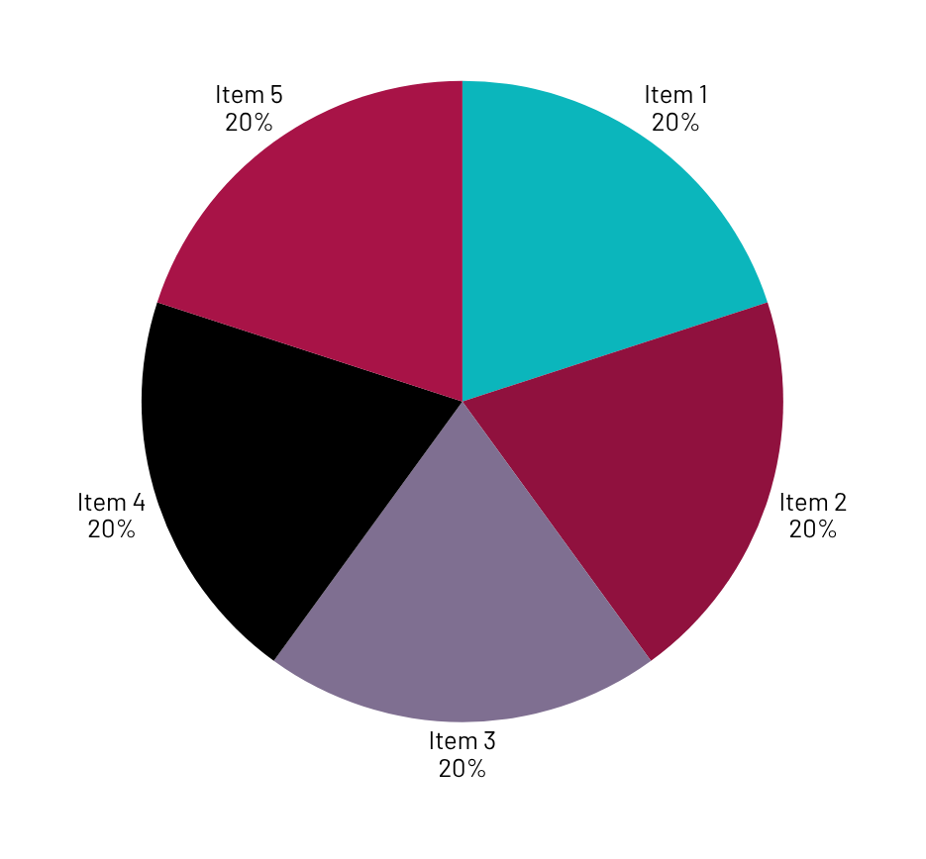
Market Size
Market Level | Basis | Estimated Opportuity
Kenya addressable universe | 9,6o9 active PBOs | 9.609 Organizations
Core SAM for an estimated Serviceable market rather than claiming every PBO needs this product. | Assume 15% have sufficiently complex multi-program M&E needs | 1440 organizations
Initial SOM | Capture 100 organizations over 3-5 years | 100 customers
Illustrative annual contract | KES 180,000 average/year | KES 18M AT 100 Customers
Core SAM revenue potential | 1440 x KES 180,000/year | KES 295M/year
Our wedge is not "convince NGOs to use data." It is: Move organizations from disconnected M&E tools and delayed reporting to one real-time intelligence layer.

Slide 8
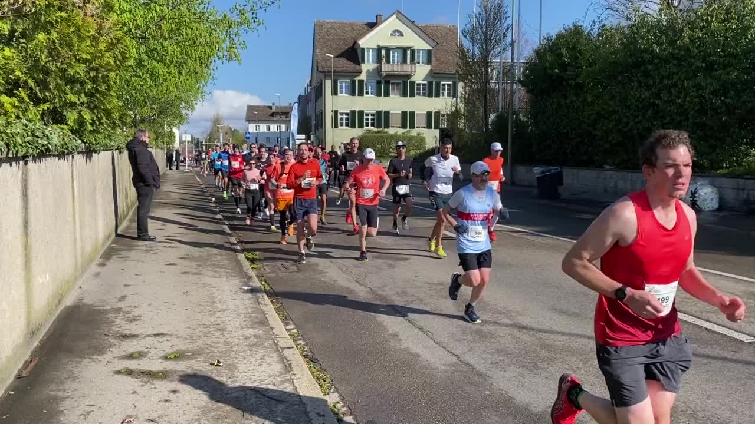
Competitors
Current Approach | Limitation
Excel/Spreadsheets | Manual consolidation
Static Reports | Historical information
Siloed Program Systems | Duplicate beneficiaries
Traditional Dashboards | Often lack unified identity management
Inuka Pulse: Provides real-time, unified, cross-pillar visibility
23

Slide 9
Competitive Advantage
What makes you unique?
Data sources → Identity Resolution → Automation → AI M&E Assistant → Executive Dashboard → Public Website
What Makes Inuka Pulse Unique?
Unified Beneficiary ID Graph.
Event-driven architecture.
Real-time updates (22-second median freshness).
Website integration without rebuilding existing site.
Public and admin views from the same data source.
Offline-first field operations.
Built directly around Inuka's operational workflows.
The strongest competitive argument is integration. Most solutions solve one part of the problem. Inuka Pulse connects: Data sources → Identity Resolution → Automation → AI M&E Assistant → Executive Dashboard → Public Website

Slide 10
Project Traction
Tasks
Month 1
Month 2
Month 3
Month 4
Month 5
Built four operational ETL pipelines.
Cleaned and validated data from all pillars.
Real-time streaming architecture.
Identity resolution service.
Public website widget.
Administrative dashboard.
Offline synchronization capabilities.
Validation
23

Slide 11
Business Model
Immediate Value
Reduced reporting effort.
Improved data quality.
Better donor transparency.
Faster decision making.
Future Monetization Potential
NGO Dashboard SaaS
Foundation Analytics Platform
M&E-as-a-Service
— Enterprise KES 500,000–1.2M+/year For large NGOs/development agencies: Multiple programs/countries Custom integrations Advanced permissions Dedicated support Custom donor reporting Advanced analytics/API access Additional revenue Initial implementation: KES 100,000–500,000 Data integration fees. Custom dashboards. Training. Premium support. I recommend a B2B SaaS + implementation model.
23

Slide 12
READY NOW
Go To Market
WHAT'S NEXT
The Prototype already has live check-ins, offline synchronization, AI-based M&E Queries, and website consistency.
• Running the dashboard with real company dataset to show its unique solution.
•Use Inuka Foundation as the design Partner and Validate the usability of our product.
• Working with NGO networks, and Youth development Programs
• Validate cost-avoidance figures with M&E lead
•Acquire Similar Organizations and Partner with them showcasing our synchronized Product
•Conducting UAT with Program officers and M&E8 staff
• We can opt for organizations with similar pain points and present our solution

Slide 13
Social Impact & SDGs
SDG 1 — Quality Education Track scholarship retention and education outcomes. Monitor vocational and digital-skills programs. SDG 2 — Decent Work & Economic Growth Track TVET employment outcomes. Track digital-skills employment and freelancing. Connect training outcomes with employer participation. SDG 3 — Industry, Innovation & Infrastructure Strengthens digital infrastructure for development organizations. Promotes data-driven program management. SDG 4 — Reduced Inequalities Enables better visibility into underserved communities. Helps organizations identify gaps in program reach.
QUANTIFIED IMPACT
43.5 officer-hours a week, back to the mission.
reduction in quarterly donor & board reporting effort
85%
auto-match rate resolving beneficiaries across pillars
96.8%
illustrative officer-time value redirected to program delivery
~KES 2.0M/yr
Illustrative hackathon estimates from Stage 1 volumes — see the Quantified Impact Memo for method and the Stage 3 validation plan.

Slide 14
Our Ask
Support Requested
Pilot implementation approval.
Stakeholder validation of impact assumptions.
Access to operational users for live testing.
Support for Stage 3 enhancements.
Stage 3 Priorities
Swahili/English toggle.
Predictive analytics.
Accessibility audit.
Expanded user validation.

Slide 15




Team Members
Apex Innovators
STANLEY METONE
KIMATHI DAVID
Jackline Mboya
PATRICK KARIUKI
Project Lead
Data Engineer
Business Analyst
QA

Slide 16
Thank you!
stanleymetone@gmail.com
+254 707394175
17

